Slide 1
Books 1-4: The Telemachy

Slide 2
BOOK 1

Slide 3
The Odyssey begins on Ithaca where we meet Odysseus’ family.
Son
Telemachus
Wife
Penelope

Slide 4
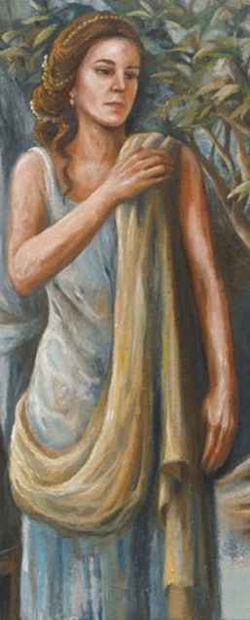
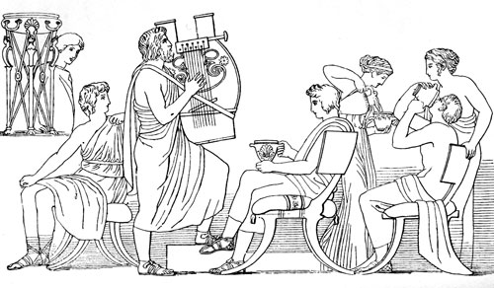
Everyone thinks Odysseus is dead except Penelope and Telemachus. Penelope’s got issues with suitors.

Slide 5
Penelope is trying her best to outsmart the suitors.

Slide 6
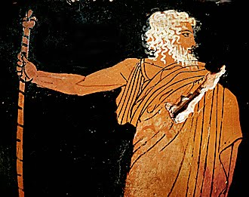
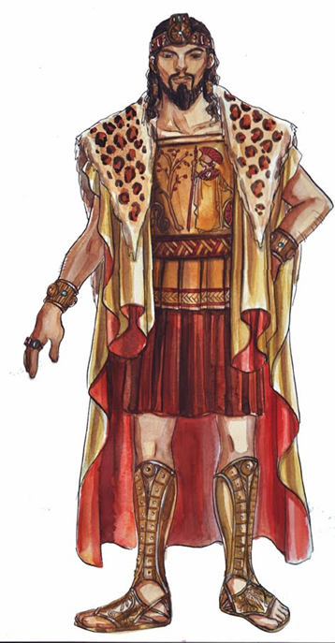
Telemachus has issues with suitors too, but Athena has a plan.
Go visit Nestor on Pylos and Menelaus on Sparta and then you shall learn the truth about your father

Slide 7
BOOK 2

Slide 8
Telemachus gathers all the men of Ithaca. Zeus sends a sign.

Slide 9
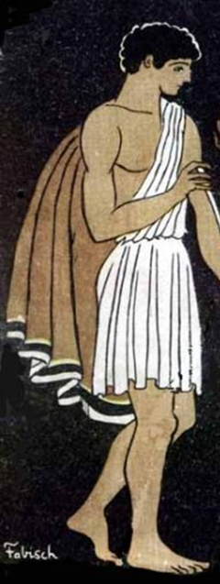
Telemachus sets sail for Pylos

Slide 10
BOOK 3

Slide 11
Telemachus meets King Nestor in Pylos
Sup old man
Greetings young man

Slide 12
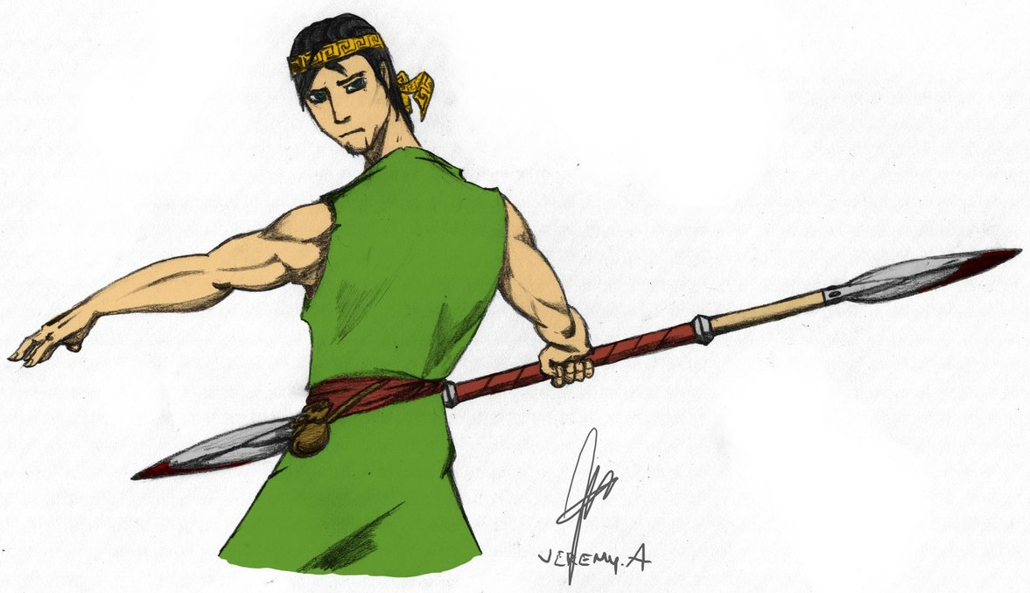
Nestor tells the sad story of Agamemnon’s fate.
Murders
Married to
Clytemnestra
Having an affair with
Agamemnon
Murders
Murders
Orestes, Agamemnon’s son
Aegisthus

Slide 13
BOOK 4

Slide 14
Telemachus and Pisistratus (Nestor’s son) visit Menelaus.
Welcome to Sparta

Slide 15
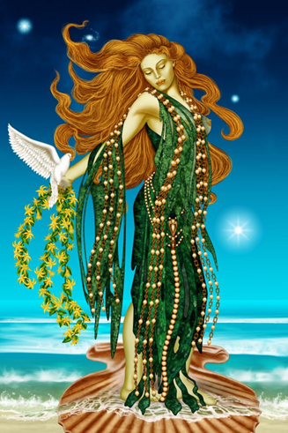
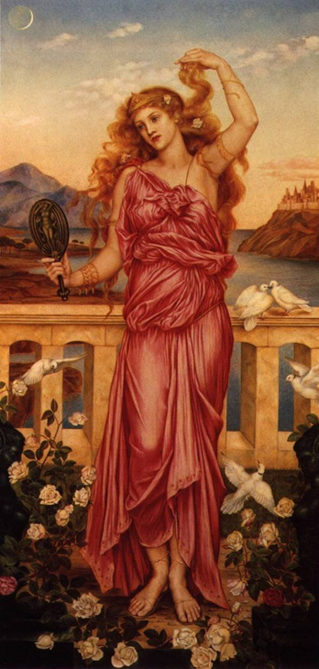
Menelaus tells of his journey home. Aphrodite is blamed for Helen’s infidelity.
It was horrible. We got stuck in Egypt for years!
I have no idea what came over me. Aphrodite made me do it.

Slide 16
Meanwhile . . . Back at the ranch, erm, I mean Back in Ithaca . . .

