Slide 1
Books 21-24

Slide 2
Book 21

Slide 3
Penelope has decided that now is the time she get married
I guess my time is up. Telemachus is a man now and Ody’s not back . . .

Slide 4
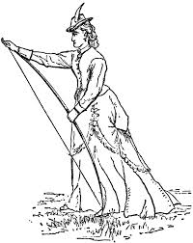
Penelope designs a contest. Whoever wins gets to marry her.
My husband was the only one to do this a long time ago, so I want my next husband to do it too. Your challenge:
String his hunting bow
Shoot an arrow with the bow through 12 axes
Hit the bulls eye on target with the arrow
1.
2.
3.

Slide 5
Many of the suitors try and fail to string the bow

Slide 6
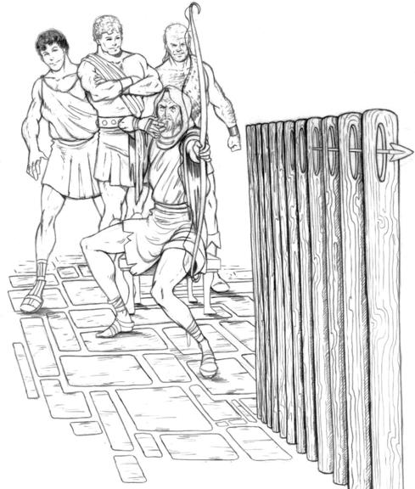
Odysseus strings the bow easily and shoots through all 12 axes

Slide 7
Book 22

Slide 8
Telemachus locks up the serving women and then locks the doors to the great hall
I got your back, O.

Slide 9
Odysseus and Telemachus kill the suitors

Slide 10
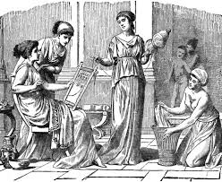
Ody asks his loyal serving maid, Eurycleia, to bring the disloyal serving maids to him

Slide 11
Ody makes the disloyal serving maids clean up the mess from the blood bath

Slide 12
Then the disloyal serving women are taken out to the harbor and hanged

Slide 13
Book 23

Slide 14
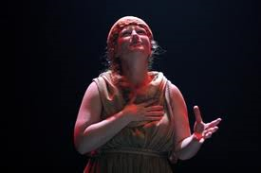
Eurycleia finds Penelope and tells her Ody has returned
Your husband has come back to us! He’s killed the suitors and everything!

Slide 15
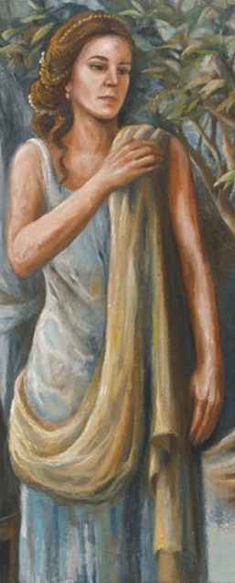
Penelope doesn’t trust him, so she puts Ody to the test
If you are who you say you are, move my bed.

Slide 16
Ody passes the test

Slide 17
They have a huge feast to celebrate Ody’s homecomeing

Slide 18
Book 24

Slide 19
Athena declares peace throughout the land and they all live happily ever after

