Slide 1
Archetypes

Slide 2
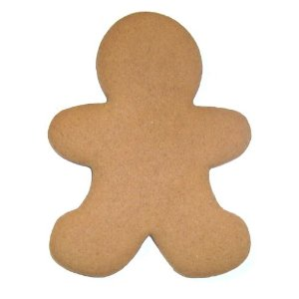
What is an Archetype?
Imagine a cookie cutter of a gingerbread man

Slide 3
Now decorate your gingerbread man . . .
Your friend will do one too . . .

Slide 4
They look so different . . .
Yet they’re both still gingerbread men
Doesn’t that make them the same on some level?

Slide 5
That’s what archetypes do . . . They take a standard form or cookie cutter image and dress up in different clothes
Their essence is the same, but their appearance sets them apart

Slide 6
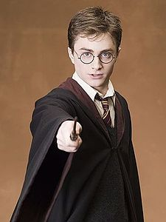
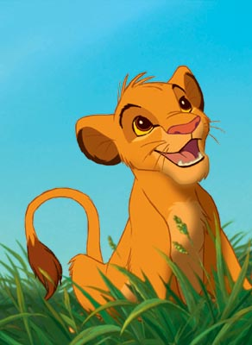
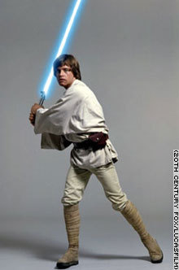
Archetype Example
Think of a HERO

Slide 7
Do they look the same, talk the same, or even experience the same things?
No
But there are certain things that make them similar:
They didn’t grow up with their parents
They have a special weapon to help them defeat evil
They suffer trauma
They go on an epic quest/journey to defeat evil

