Slide 1
Art and Artists in My Name is Asher Lev

Slide 2
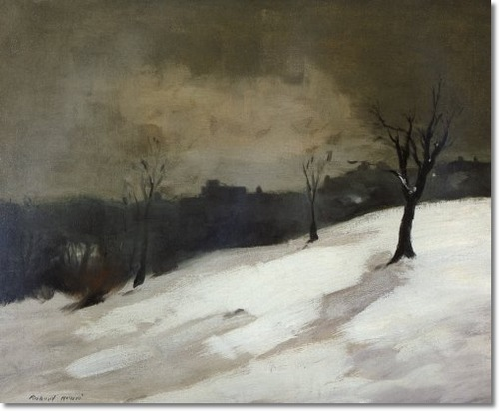
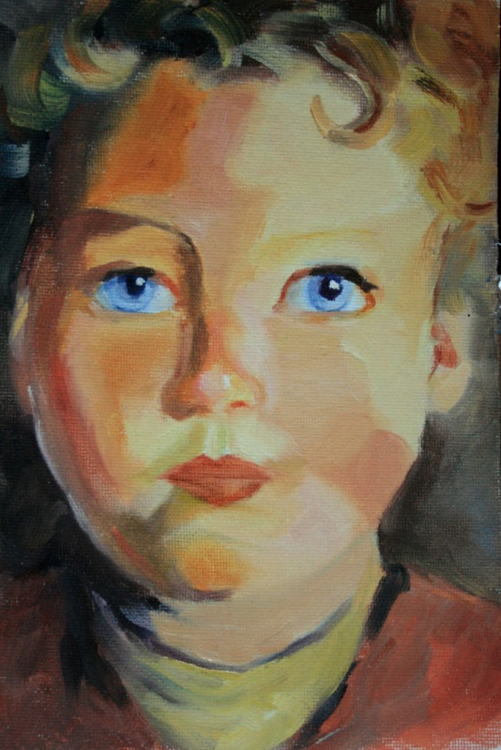
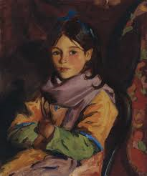
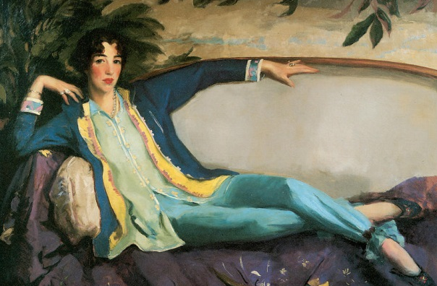
Robert Henri
Notes:
American realist painter
Began the Ashcan School and encouraged artists to make “pictures from life.” They often captured the rapidly changing landscape of New York and usually featured the bleak and seedy aspects of city life
Ashcan School painters were sometimes referred to as “the apostles of ugliness”
Why would Asher be drawn to Henri?
What parallels can you draw between Asher and Henri?

Slide 3
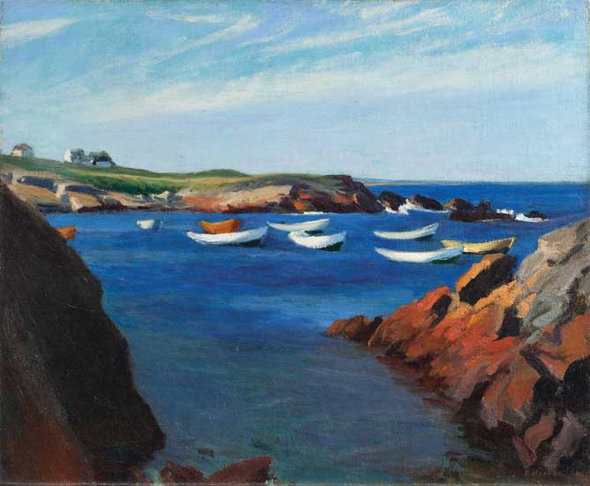
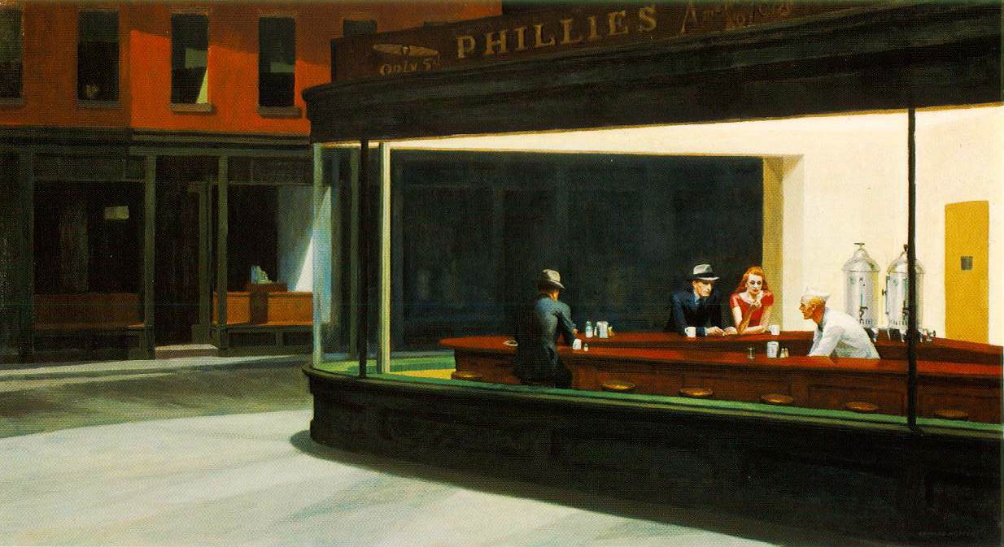
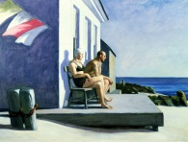
Edward Hopper
Notes:
American Painter whose scenes express a common theme: loneliness
His most famous painting is Nighthawks where four people sit inside Phillies, ignoring each other echoing the loneliness of modern humans
Asher is captivated most by Hopper’s sunlight
Even in these paintings notice the feelings of solitude and loneliness
Top Left: The Long Leg: solitary sailboat with a solitary house behind
Top Right: notice none of the boats have people in them. There is a single house in the background
Bottom Right: Even though there are two people here, neither acknowledges the other. Instead, both look longingly out to sea and ignore each other.
Why would Asher be drawn to Hopper?
What parallels are there between Asher and Hopper?

Slide 4
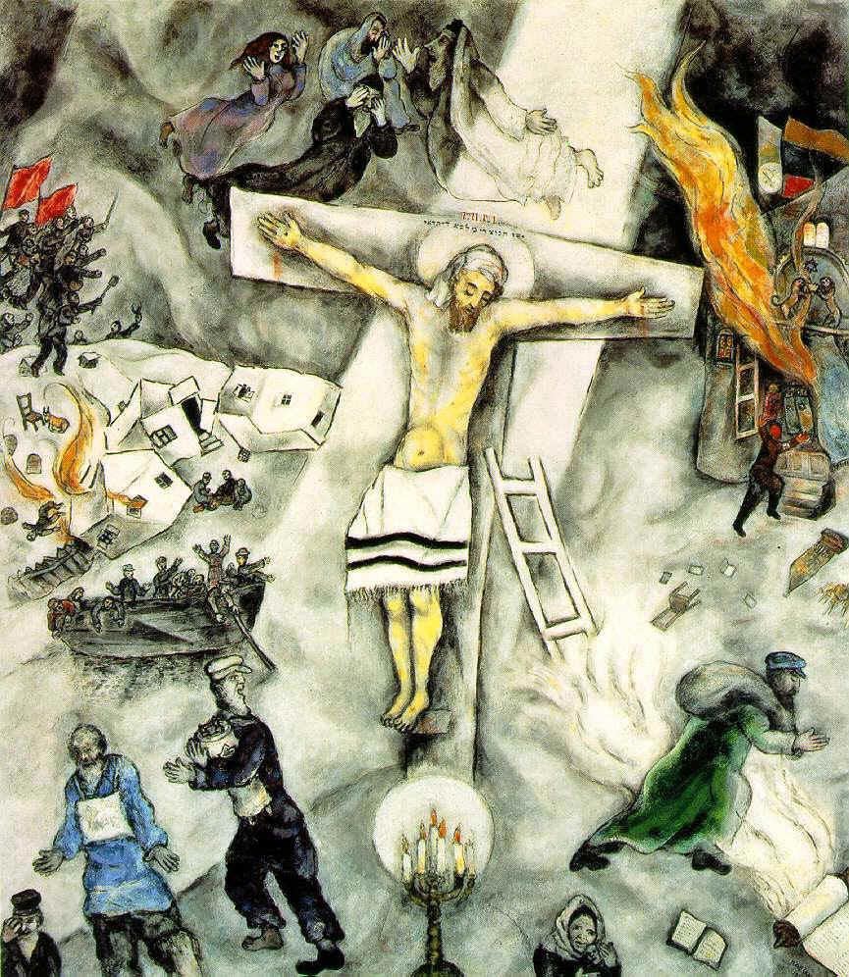
Marc Chagall
Notes:
It’s very possible that Asher’s story is in some way Chagall’s story
Chagall was born in a small town in Russia, Vitebsk, to a Jewish family
At school, he saw another boy drawing and was fascinated by it. Soon he started to copy pictures out of books and fell in love with painting
His family, being traditional Jews, did not have art around the house
Chagall was most fascinated with painting scenes from his Jewish childhood or the bible
Although critics described him as a precursor to surrealism, he insisted that he painted actual memories and not irrational dreams
I and the Village: A childhood spent in rural surroundings. The top right is a rendering of his hometown, The green faced man is often considered his self portrait (note the cross around his neck), the sheep are common themes in many of Chagall’s paintings representing the pastoral peace. Dreamlike, notice the tree of knowledge in the bottom center
White Crucifixion: This turns the concept of a crucifixion on its head because it is most often seen as a symbol of oppression by the Jewish people, but here it is a symbol of Jewish oppression. In the center is a pained and suffering Jesus on the cross. He wears a prayer shawl representing his Jewish roots.
All around him are acts committed against the Jewish people: on the left, a village is pillaged and burned, people escaping by boat and three bearded men escaping on foot (one clutching the Torah); on the right, burning synagogue; the green figure is considered the Jewish wanderer runs for his life; bottom a Jewish mother comforts her child; top three Jewish patriarchs and a Jewish matriarch watch in horror as the events unfold.

Slide 5
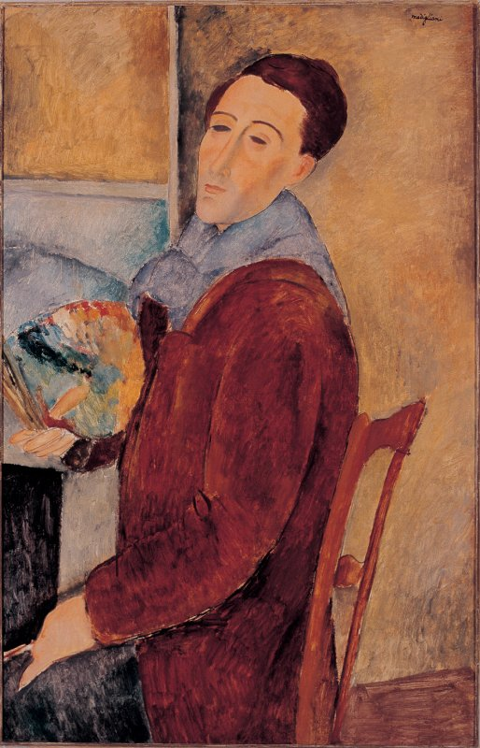
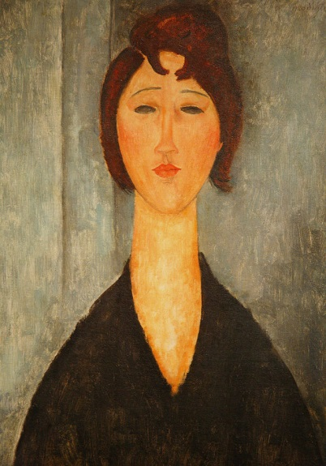
Amedeo Modigliani
Notes:
Jewish-Italian born
He was very close to his mother and it is she who encouraged him to pursue art and saw that he had a talent for it
He was very sickly, contracting several illnesses as a childhood.
His art features mostly portraits with his signature look of an elongated face
Moved to Paris to paint and developed quite the reputation
Poor as all get out, yet he dressed in all the finest clothes
He would sometimes strip down in local cafes and shout to patrons, “Look at me, don’t I look like a god?”
Treated his mistress horribly, once throwing her out a window
Drank to excess
Tried many different kinds of drugs
On the night he died, he sold his suit to buy more wine, caught pnemonia, and died. He was 35.

Slide 6
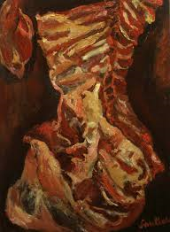
Chaim Soutine
Notes:
Jewish-French born
Friend and roommate of Marc Chagall
He was often criticized for keeping animal carcasses in his room to paint them. The smell got so bad the neighbors called the police a couple times
When the Germans invaded France, he needed to go into hiding, often moving from one place to another to avoid the Gestapo
He eventually died from a badly bleeding stomach ulcer and the failed surgery he underwent to try to correct it

Slide 7
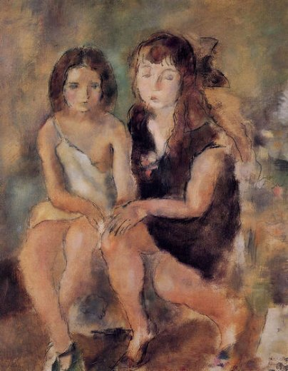
Jules Pascin
Notes:
Bulgarian-Jewish born
Moved to Paris to be part of the early 20th century art movement
Painted mostly prostitutes waiting for clients and favorite medium was watercolor
Struggled with poverty: he was known to throw lavish dinner parties any time he had money and when invited to other people’s houses, he would have as many wine bottles as he could carry.
Desired acceptance but convinced himself that he was lesser or unworthy. He suffered from alcoholism and depression all his life
At age 45, he slit his wrists and hanged himself, writing his last message in blood on the wall to his former mistress

Slide 8
Picasso’s Guernica
Notes:
Picasso is considered one of the greatest painters of all time
Largely influential: spearheaded the movement of Cubism which took 3D shapes and flattened them into 2D perspective
Guernica was a town in the Basque region (southern France and northern Spain)
April 26, 1937 Guernica was almost totally destroyed by Nazi bombers acting on behalf of the rebel (Spanish) general Francisco Franco
The Germans attacked during the busiest hour of a market day, they killed or wounded many of the 7,000 citizens
Picasso created this to condemn the senseless bombing without specific reference to the event—no bombs or planes
Rendered to capture the visceral outcry of human grief
Bottom: slain warrior holding a broken and useless sword
Gored horse tramples the warrior
Left: woman holds her dead child
Right: Woman runs screaming from burning building
Upper Left: The bull: represents brutality and darkness (according to Picasso)

Slide 9
Michelangelo’s The Last Judgment
Notes:
Commissioned by Pope Paul III; Sistine Chapel
The New Testament states that one day Christ will return to earth to exact judgment on mankind.
In the center is a very angry Jesus prepared to strike down and destroy all
The choirs of heaven surround him; the just and good are ascending on clouds or being pulled into the air by angels while the unjust and evil are being hurled earthward or dragged into hell below
On the left, the dead awake and assume flesh, on the right demons torment the damned

Slide 10
Michelangelo’s The Last Judgment: Charon Striking his Doomed Passengers
Notes:
In Greek myth, Charon was the ferryman who would take recently deceased souls across the River Styx to the underworld
It’s important to know that in Greek times, they didn’t think of the underworld as hell, but rather just the place where dead people go
However, Christians see Charon’s duties as bringing condemned souls into hell
Here he raises his oar to strike his passengers
All cower and some try desperately to escape his wrath by jumping off the boat
Look at his face: overcome with madness and contempt

Slide 11
Michelangelo’s The Last Judgment: Man Being Pulled Headlong into Hell by Serpentine Demons

Slide 12
Michelangelo's David
Notes:
Commissioned by the Florence Cathedral building committee
Political statement: stability of the Florentine republic and David was considered the defiant hero for it
How does this connect to Asher: Stability of his family and his Jewish roots certainly in jeopardy: he becomes his own symbol of defiance and strength
This does not represent the victorious David, but rather the one sternly regarding his approaching Foe; muscles are taught, veins are bulging, face is concentrated
Asher has demons of his own to stand up and conquer
Presents an image of “towering pent-up emotion” rather than “calm, ideal beauty.” His own doubts, frustrations, and passions are evident in the entire composition of David

Slide 13
Michelangelo’s Pieta (Duomo)
Notes:
The four figures: Left Mary Magdalene, Back Nicodemus or Joseph of Arimethea, Right Virgin Mary, Center Jesus Christ
Mary Magdalene: Travels with Jesus as one of his followers. She was present for both the crucifixion and resurrection of Jesus. She was thought to have been possessed by seven demons which Jesus cast out of her. She stayed with Jesus during his crucifixion even after all the other disciples fled and was the first to realize his resurrection and the implications. She has a reputation of being a harlot before she met Jesus, but much of this is speculation.
Nicodemus: Pharisee who showed favor to Jesus. He and Joseph of Arimethea are present after Christ has been crucified and it is they who help prepare the corpse of Jesus for burial.
Virgin Mary: Jesus’ mom. She was present to see her son crucified.

Slide 14
Brooklyn Crucifixion
Notes:
Like Asher, Chaim Potok is also a Jewish painter. Here is his rendition of one of Asher’s Brooklyn Crucifixions

