Slide 1
Jewish Traditions and Culture

Slide 2
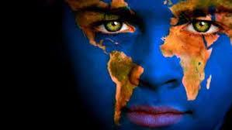
What is Culture?
The dictionary describes it as “The attitudes, feelings, values, and behavior that characterize and inform society as a whole or any social group within it”
Food
Clothing
Traditions/Celebrations
People/Leaders/Government
Language
Religion
Arts

Slide 3
Food
No pork or shellfish
Meat and Dairy cannot mix
Kosher foods: meat that has been slaughtered by a shochet (ritual slaughterer), completely drained of blood, soaked in water for at least a half hour, and salted to drain any remaining blood
Matzo: Unleavened Bread; eaten during Pesach (Passover)
Notes:
Matzo: Unleavened bread refers to bread that does not have yeast in it. Yeast is the substance that allows bread to puff up and become light and fluffy. Bread baked without yeast turns out like a dense cracker.
When the Jews escaped slavery in Egypt, they did not have a chance to wait for the bread to rise, eating unleavened bread instead
To commemorate this, Jews do not eat leavened bread of any kind for the seven days of passover

Slide 4
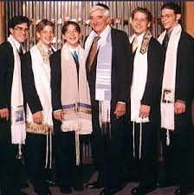
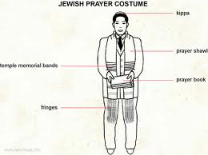
Clothing
Payos: Sideburns
Skull Caps
Ritual Fringes
Prayer Shawl
Notes:
Payos: The Torah states that men should not round off their payos or sideburns. This means that they cannot be shaved off or removed with tweezers. The Torah does not restrict men from cutting their payos short, but many choose to grow out their hair to emphasize their piety and devotion to Torah.
Skull Caps: a small, platter-shaped hat that fixes to the back of the skull for men. There is some debate about the meaning of the Torah. Some believe that a skull cap should be worn at all times to honor the commandment that men should have their heads covered at all times; others believe that it is only necessary during prayer
Ritual Fringes: Specially knotted lengths of string attached to the four corners of the prayer shawl and the everyday undergarment. It’s purpose is to remind Jews of their religious obligations at all times and the wearing of it is in the commandments.
Prayer Shawls: worn in the synagogue and wrapped over the shoulders of the wearer. It is designed to remind the wearer of their obligations to God

Slide 5
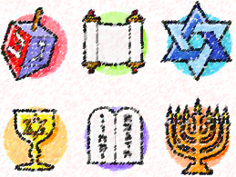
Traditions/Celebrations
Rosh Hashanah: Jewish New Year; falls in September or October
Yom kippur: Day of Atonement; Falls in September or October
Hanukah: Festival of light; falls in November or December
Pesach: Passover; falls in February or march
Shabbos: Sabbath; is observed every week beginning Friday evening and lasting until Saturday evening
Bar Mitzveh: A coming of age celebration for boys who turn 13
Notes:
Rosh Hashanah: Jewish New Year; falls in September or October
Celebrated in the seventh month of the Jewish calendar, Tishrei. This is the month God created the world
During this time, Jews must examine and assess their lives from an ethical and religious perspective.
Yom Kippur:
Also celebrated in Tishrei.
Similar function to Rosh Hashanah, reexamining one’s life religiously and ethically
Hanukah:
Celebrated in the ninth month of the Jewish Calendar, Kislev
Syrians in 167 B.C.E. invaded a Jewish Temple and desecrated it. As part of the purification process, the Jews wanted to burn uncontaminated olive oil; however, they only found on container of untainted oil good only for one day.
The Jews feared that they would need eight days to prepare more oil. Miraculously, when they lit this small bit of oil, it burned for eight days and nights thus giving them the time they needed to create more oil and purify their temple
Pesach:
Celebrates God freeing Jewish slaves from Egypt
Also celebrates the beginning of Jewish nationhood (Israel)
Most widely observed Jewish holiday in the world
Shabbos:
The fourth commandment asks that men “honor the Sabbath” as a day of rest for God created the world in six days and on the seventh he rested
They are not supposed to work on the Sabbath: for Orthodox Jews that means not even flipping on a light switch
Jews honor this every Saturday (and Friday evening)
Bar Mitzveh
For boys: this happens at the age of 13 when they are considered responsible for their actions
They must read and study Torah, agree to follow the 613 Jewish commandments, and follow the other guidelines of the community

Slide 6
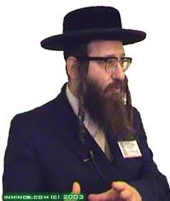
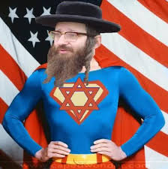
People/Leaders/Government
Rebbe: Teacher of Torah; Considered the leader in most Jewish societies
Mashpia: Person of influence; can work as leader in Rebbe’s absence
Reb: A sign of respect; similar to saying Mr.

Slide 7
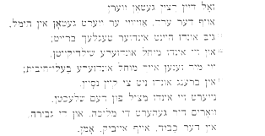
Language
Hebrew: Considered the original language of the Jewish people (it’s their Holy Tongue)
The Torah is written in Hebrew
https://www.youtube.com/watch?v=IEZjEBn8EF8
Yiddish: uses the Hebrew alphabet (it’s their common tongue)
https://www.youtube.com/watch?v=PNZgeGAsLuk

Slide 8
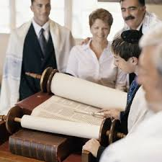
Religion
Torah (aka Chumash): The first five books of the Old Testament. Considered the central document for Judaism.
Zemiros: Jewish hymns, often taken from poems written by Rabbis
Krias shema: Jewish prayers said before bedtime; believe they are prayers of protection
Ribbono shel olom: Hebrew term adopted into Yiddish to refer to the “Master of the Universe” or G-D
Sitra achra: “The Side of Impurity” or “The other Side”
Synagogue : House of Worship

Slide 9
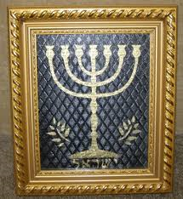
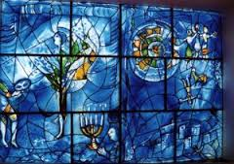
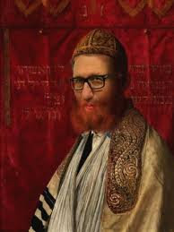
Arts
Jews have been conflicted by two opposing views regarding art:
The first is they believe they are tasked by God to make the commandments beautiful
The second is that the 2nd commandment says they are forbidden to create graven images
As a result of this conflict, Jewish art is often biblical or traditional in nature

Slide 10
What do you think about your culture?
Writing Prompt—Choose one aspect of culture and write about that aspect from your culture’s perspective. Does it really show who you are? Do you seem to be like others your age? Why or why not? Tell a story about it. When you are finished, turn in your paper.

