Slide 1
The Middle Ages

Slide 2
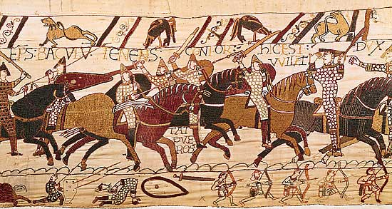
1066-1099
1066 Norman Invasion
Normans left a legacy of law and order and cultural unity on the Anglo-Saxon culture
1086 Domesday Book compiled by order of William the Conqueror
1095 Crusades begin
Notes:
As you may recall from our look at the Dark Ages, the Normans were from Northern France. In 1066, during the Battle of Hastings, Duke William of Normandy (William the Conqueror) defeated the last Anglo-Saxon King, King Harold. Their invasion subjugated England under French rule for centuries. Unlike the Romans, the Normans never withdrew from England.
The Domesday Book is a record of all the land ownership in England ever first recorded. This administrative feat meant that for the first time in history, English subjects could now be taxed on what they owned.
The Crusades were fought between European Christians and Muslims with Jerusalem as the holy land and ultimate goal. Although the Europeans were unsuccessful in holding Jerusalem, they benefitted enormously: mathematics, astronomy, architecture, and crafts (artisans)

Slide 3
1100-1149
Pope
William the Conqueror
Rise of Feudalism
Barons/Landowners
Knights
Serfs
Notes:
Feudalism was a caste system. At the top of the pyramid (with all the power) was William the Conqueror. He in turn appointed Barons to certain parcels of land in England. The Barons then appointed their own knights and serfs who swore allegiance to the Baron. This displaced the Anglo-Saxon idea of mutual protection and respect with an idea that you were born into your status. If you were born landless and penniless, then you deserved to be treated as a second class citizen. Serfs and Knights born into poverty were not allowed to leave the land the worked.
This didn’t always work out. If serfs had lords who were weak, they could choose not to defend the castle against invaders.
However, knights remained very loyal to their overlords. In fact, it is from the knights that we get our code of chivalry: the ideas of being loyal to one’s master, of observing certain rules of warfare (not kicking an opponent while he is down), and treating women with respect and devotion. Thus, the battles of armor-clad knight battling with each other becomes one of the most enduring symbols of the middle ages.
Unlike in Anglo-Saxon culture, Women in this culture had no voice, owned no property, and were considered subservient to men. Her father’s or husband’s social class determined the level of respect she was entitled to. Peasant women lived in an endless world of childbearing, housework, and fieldwork. Women of higher status spent their time bearing children and supervising the household.

Slide 4
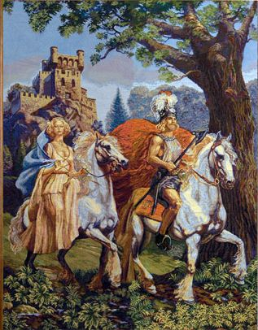
1150-1199
1171 King Henry II invades Ireland
Circa 1170 Chretien de Troyes writes Lancelot
Notes:
Up until this point, Ireland was a free and independent nation. Henry’s invasion marks the beginning of almost 800 years of British domination.
King Henry II was a catholic king. Even he was a vassal under the pope. This demonstrates the stronghold Catholicism had over all of Europe. The church also remained the center of cultural unity and learning.

Slide 5
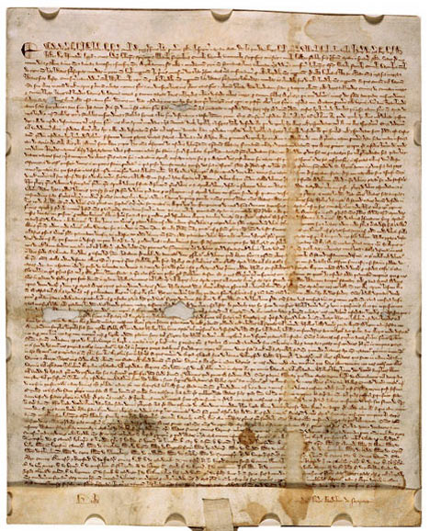
1200-1249
1215 King John is forced to sign Magna Carta
Barons forced him to sign
Notes:
Return to democratic order in England. Though John had strong support from the Pope, the English Barons forced him to sign this document that took power away from the pope and gave that power over to the Barons: trial by jury and taxation only with representation in the legislature. While this served as a great advancement for landowners, commoners still did not have any rights. However, the Magna Carta laid the foundation for English constitutional law as well as American Democracy.

Slide 6
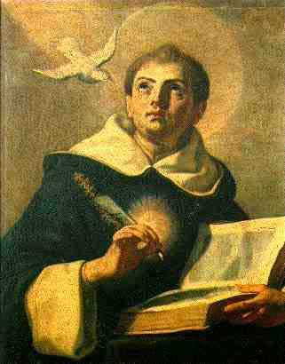
1250-1299
1250 Commoners allowed in Parliament
1266-1273 Thomas Aquinas writes Summa Theologica
1270 Crusades end
1296 Edward I invades Scotland, declares himself king

Slide 7
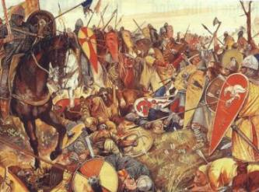
1300-1349
1337 Hundred Years’ War Begins
1327-1377 Edward III
1413-1422 Henry V
1348 Black Plague strikes England
Notes:
The Hundred Years’ War was fought between England and France. At its core, this conflict was over two English Kings who claimed the throne of France, Edward III and Henry V. The war was unsuccessful for the English, but did help establish an English identity separate from their Norman invaders. The English no longer saw themselves as knights in shining armor, but as yeoman (small landowners) with long bows (an invention in fact from Whales).
The Black Plague was especially significant at this time because it reduced the nation’s population by one third. This caused a labor shortage and gave more bargaining power to the remaining vassals. Many elected to move to towns and join the newly formed merchant class. This outbreak of plague ensured the end of feudalism in England.

Slide 8
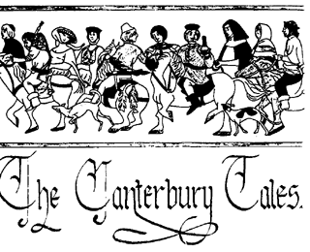
1350-1399
1362 English Language used to open Parliament
1375 Sir Gawain and the Green Knight written
1378 Robin Hood stories appear
1380 Bible translated into English for first time
1387 Chaucer begins Canterbury Tales
1381 Peasants’ Revolt in England
1399 King Richard II deposed

Slide 9
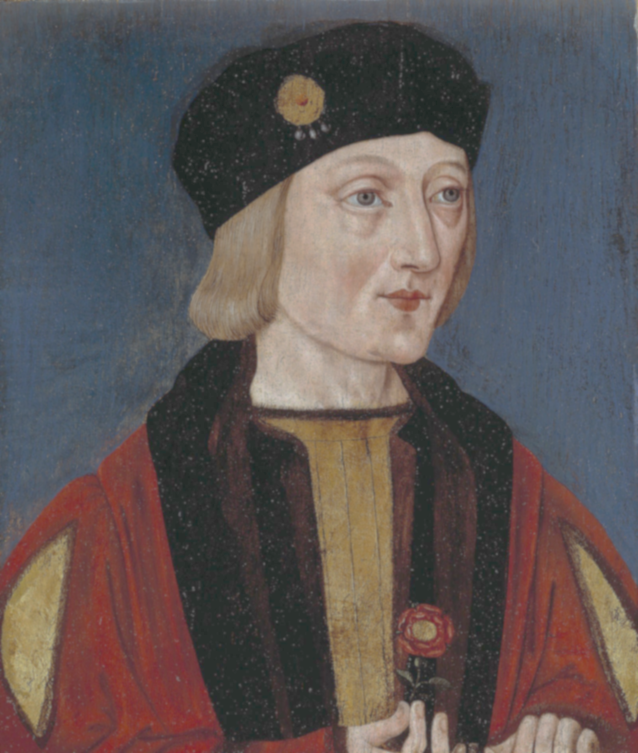
1400-1485
1431 Joan of Arc burned at the stake by English
1455 First book printed with Gutenberg press
1455-1485 War of the Roses
1485 Le Morte Darthur first published
1485 Henry VII crowned king
Notes:
The War of the Roses was a conflict between the houses of Lancaster and York. Each claimed that his house was legitimately entitled to the throne of England
The Gutenberg press meant that for the first time in history, written work could be mass-produced and thus disseminated across towns, cities, and countries. It meant that books were no longer rare and it meant that there was more than one copy in existence. Books no longer needed to be hand written.
Le Morte Darthur was written by Thomas Malory. It is a compilation of the Arthurian Legends.
Henry VII was from the house of Lancaster (the victors of the War of the Roses), but he married Elizabeth of York, thus uniting the two houses and giving both a legitimate claim to the throne. His last name is Tudor, so he is often referred to as the first Tudor king. His ascent to the throne marks the beginning of the English Renaissance.

Slide 10
A Look at Middle English
Recognize it this time?
Oure fadir that art in heuenes, halewid be thi name; thi kyndoom come to; be thi wille don in erthe as in heuene: gyue to us this dai oure breed ouer othir substaunce; and forgyue to us oure dettis, as we forgyuen to oure gettouris; and lede us not in to temptacioun, but delyuere us fro yuel.
Video Clip

Slide 11
Lord’s Prayer Middle English Style
Our Father, which art in heaven, Hallowed be thy Name. Thy Kingdom come. Thy will be done in earth, As it is in heaven. Give us this day our daily bread. And forgive us our trespasses, As we forgive them that trespass against us. And lead us not into temptation, But deliver us from evil. For thine is the kingdom,
The power, and the glory,
For ever and ever.
Amen.
Oure fadir that art in heuenes,
halewid be thi name;
thi kyndoom come to;
be thi wille don in erthe
as in heuene:
gyue to us this dai oure breed ouer othir substaunce;
and forgyue to us oure dettis,
as we forgyuen to oure gettouris;
and lede us not in to temptacioun,
but delyuere us fro yuel.

