Slide 1
Book 10

Slide 2
Ody and his men arrive at Aeolian island

Slide 3
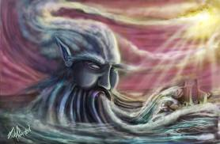
Aeolus Likes Ody and wants to help him
I like you, and Poseidon’s a poop. Take this bag of wind. It will bring you home
Oh yeah, and don’t open the bag for any reason!

Slide 4
Ody’s men mess everything up

Slide 5
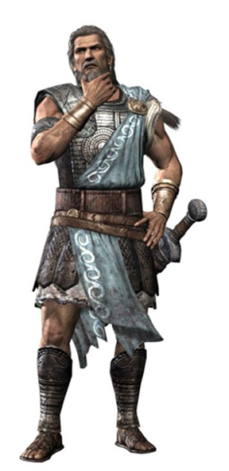
Aeolus refuses to help a second time
A man like you must be cursed. Go away before you break something!

Slide 6
The men then sail to laestrygonian land

Slide 7
King antiphates doesn’t give them a warm welcome

Slide 8
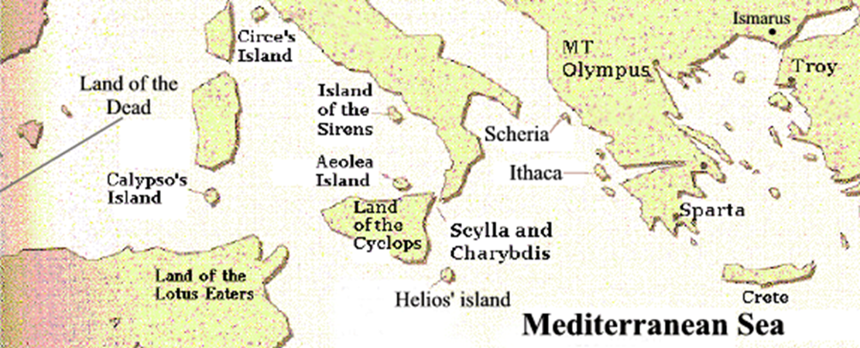
Ody and his men make their way to Aeaeian Island, home to Circe

Slide 9
Ody splits his men into two groups: team ody and team eurylochus
You guys go investigate. We’ll stay here and set up camp.
Whatever you say, boss.
Team Ody
Team Eurylochus

Slide 10
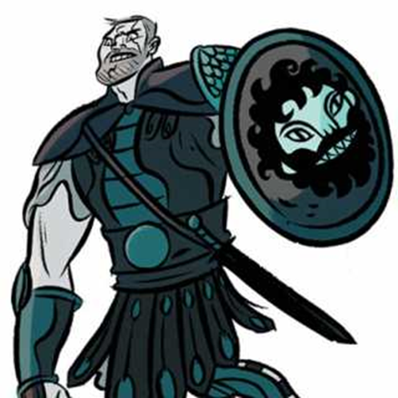
Team eurylochus meet circe; eurylochus escapes
She be cray cray! I’m out!

Slide 11
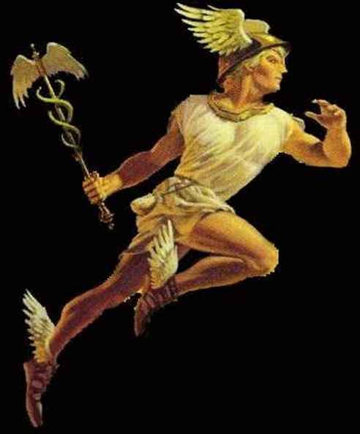
Ody’s on a mission to save his men. Hermes helps him with a moly flower

Slide 12
Ody follows hermes’ instruction
I’m immune to your wiles.
Why aren’t these spells working?
Now I’ll have to kill you
No, don’t kill me. We can work something out . . . Sleep with me?
I’d be ok with that

Slide 13
Spends a year as circe’s lover before deciding he wants to go home
Ok.
Baby, this is cool and all, but I think I’m gonna go. . .

