Slide 1
Book 5

Slide 2
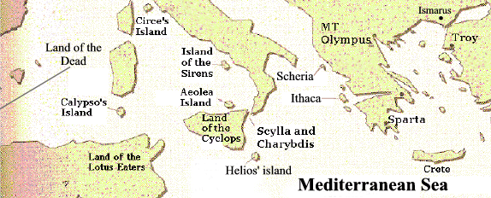
Finally we meet Odysseus who has been living on Ogygia for 7 years with Calypso

Slide 3
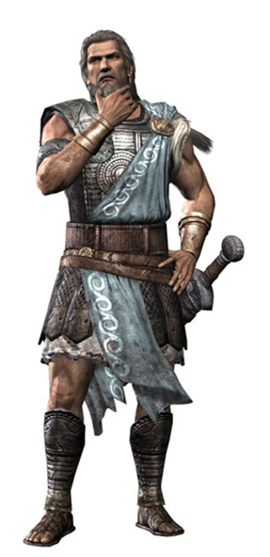
Calypso offered Odysseus immortality in exchange for love

Slide 4
Time-out: isn’t odysseus married?
Yup, so let’s talk about the Greek laws of marriage and adultery:
Married girl sleeps with another guy
she’s a slut
Married guy sleeps with another girl
he’s a stud; as long as he’s thinking of his wife while he does it

Slide 5
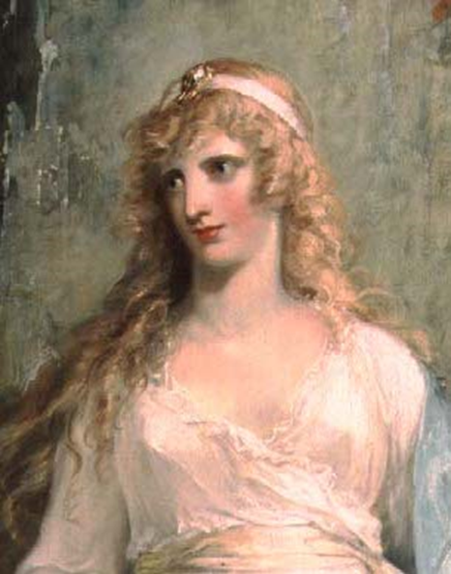
Ody thinks this sounds like a pretty good deal

Slide 6
Athena makes Zeus send hermes to tell Calypso to set ody free
You’ve got to let him go
But, but, but

Slide 7
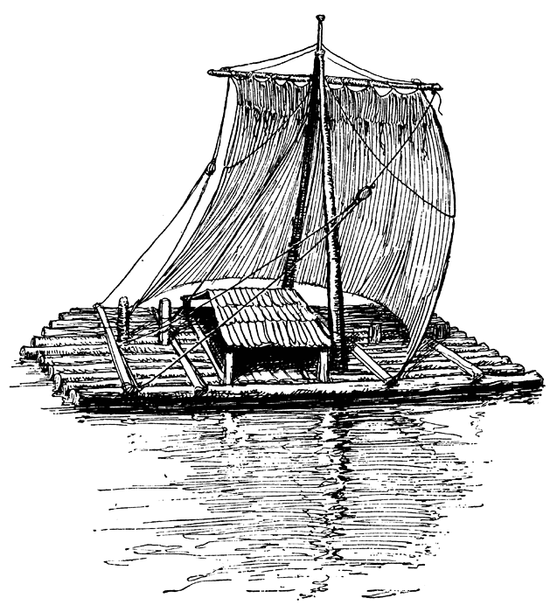
Odysseus builds a ship and sails for ithaca

Slide 8
Poseidon is angry. Destroys Ody’s ship
Oh heck no!

Slide 9
Ino takes pity and rescues Ody

