Slide 1
Books 11 and 12

Slide 2
Book 11

Slide 3
Ody and his men go to the underworld per Circe’s instructions

Slide 4
Timeout: What is the underworld?
A place where dead people go.
Underworld Hell

Slide 5
They summon the shades of the underworld

Slide 6
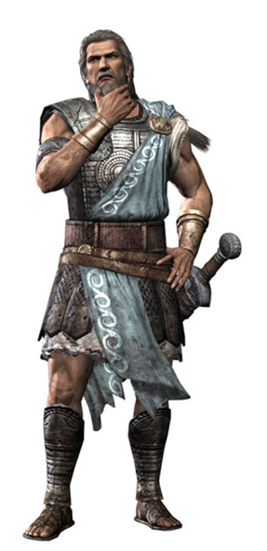
Tiresias arrives and tells ody his future
You’ll get home as long as you aren’t so prideful
You’ll come to Hyperion’s island. Don’t eat the golden cattle!
If you can do all that, you’ll get home and die a peaceful death when you’re an old man.

Slide 7
Ody talks to anticlea (his mom). The men leave, broken hearted.
Your son and wife are still alive
Penelope is loyal to you.

Slide 8
Book 12

Slide 9
Ody and his men sail towards the sirens

Slide 10
Ody thinks of a way to get past the sirens without incident

Slide 11
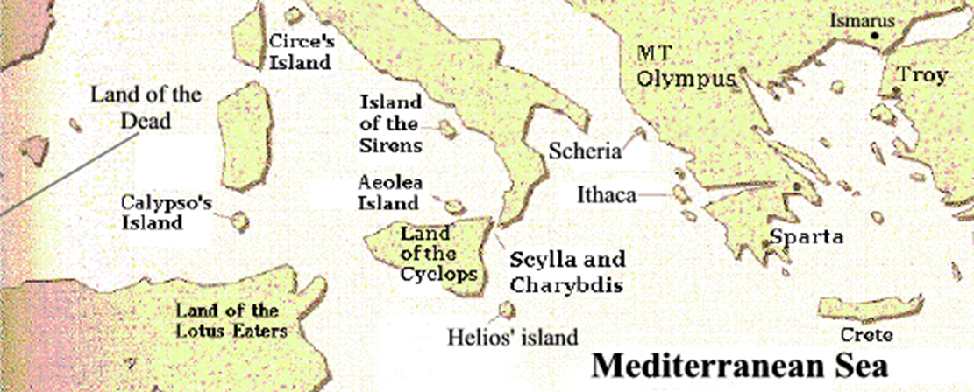
Next comes Scylla and charybdis

Slide 12
Scylla
Charybdis

Slide 13
Then they arrive at the isle of the sun god, Lord hyperion

Slide 14
Odysseus give his men one rule while they’re on hyperion’s island
DON’T EAT THE
GOLDEN CATTLE!!!!

Slide 15
Hyperion is angry. Ody and his men get punished
Nobody eats my cows and gets away with it!

Slide 16
ody goes back through Scylla and charybdis

Slide 17
Swims to the island of ogygia where he meets calypso and spends 7 years with her
Be my love.
Sounds like a good deal to me

