Slide 1
Book 9

Slide 2
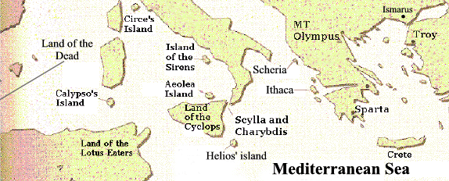
Ody sails from Troy. Reaches the land of the lotus eaters.

Slide 3
Island belongs to hypnos (sleep) and Morpheus (dreams).

Slide 4
Ody refuses to eat the lotus and drags the rest of his men back to the ship.

Slide 5
Next, they arrive at the land of Cyclops in needing food, drink, and to make repairs to their ships.

Slide 6
Ody and 9 of his men explore the island and find a giant cave.

Slide 7
The cave has everything they need for their journey.

Slide 8
The owner of the cave, polyphemus, returns.
Strangers, I know you’re in here. Show yourselves!

Slide 9
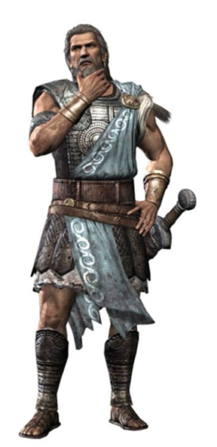
Polyphemus and Ody chat about Troy . . .
Tell me a story and it may be I spare your life.
Well, there was this one time in Troy when I fought some battles. . .

Slide 10
. . . It doesn’t go well.
That story was dumb

Slide 11
Odysseus has a plan to escape.

Slide 12
Odysseus gets Polyphemus drunk on some of the wine he brought.

Slide 13
Polyphemus is blinded. When he says nobody did it, the other Cyclops laugh at him.

Slide 14
Ody and his men escape tied to the undersides of sheep.

Slide 15
They return to the ship. Odysseus does something really stupid.
Ha ha. My name is really Odysseus and don’t you forget it!

Slide 16
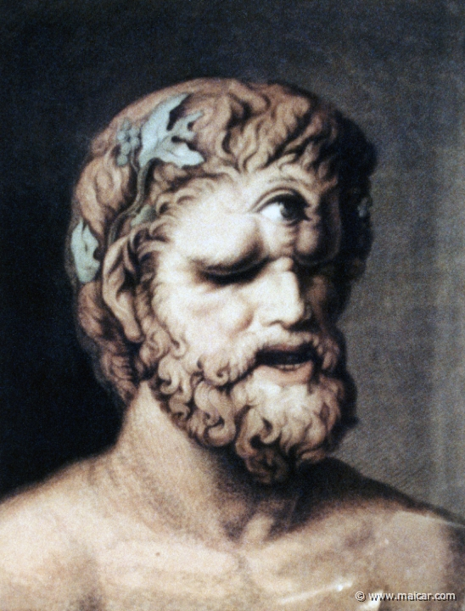
Polyphemus reveals his father is Poseidon. Ody is in big trouble.
Oh yeah? Joke’s on you Odysseus. My dad’s Poseidon and he’s going to kick your butt.
Uh oh. That was dumb.

