Slide 1
Books 18-20

Slide 2
Book 18

Slide 3
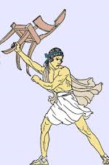
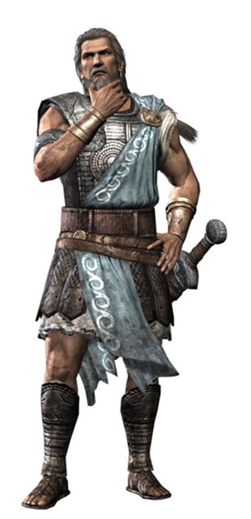
In the palace, Irus, another beggar, fights with Ody
This palace ain’t big enough for the both of us.

Slide 4
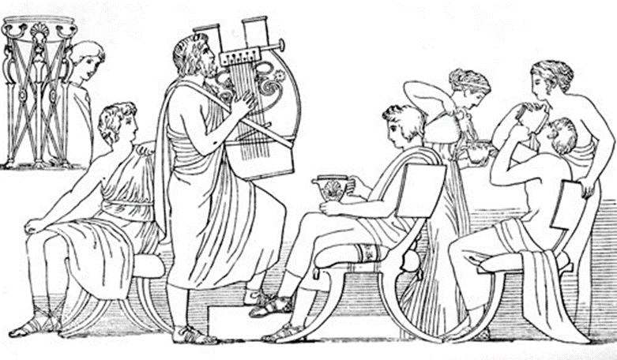
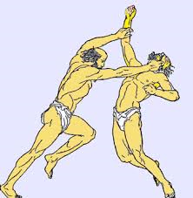
The suitors host a boxing match between Ody and Irus for entertainment
Fight! Fight! Fight!

Slide 5
Ody kicks butt

Slide 6
Book 19

Slide 7
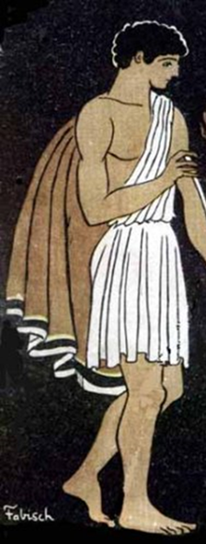
Ody tells Telemachus to start locking up the weapons
Whatever you say, dad.
It’s time to carry out our plans, son.
Yes, hi suitors. We’re conducting a routine weapons collection drill, so um, hand them over.

Slide 8
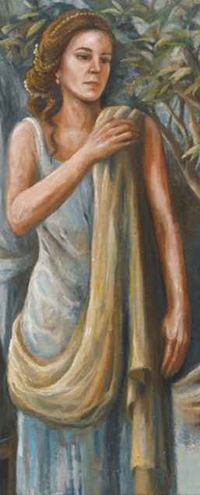
Ody puts Penelope to the test
So, some of those suitors are pretty cute, right? Am I right?
They’re not my type.
You should have someone wash my feet.
Of course. Pardon my manners.

Slide 9
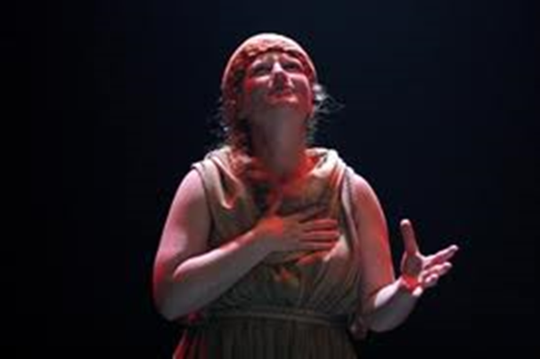
Eurycleia recognizes Ody and almost gives his identity away
I know that scar. You’re Ody--
Shhhh. You’ll ruin the whole plan. Tell no one.

Slide 10
Penelope puts Ody to a test
So I’m thinking about getting married.
I won’t settle for just anyone, though. They’ll have to pass my test first.

Slide 11
Book 20

Slide 12
Telemachus gives the orders to prepare a feast
Let’s get this party started!

Slide 13
The suitors mistreat both Ody and Telemachus
We fart in your general direction. Your mother was a hamster and your father smelt of elderberries.

