Slide 1
Books 6-8

Slide 2
Book 6

Slide 3
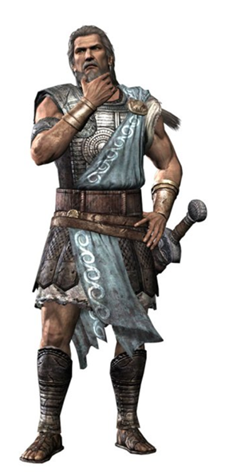

Exhausted and naked, Ody arrives at phaeacia

Slide 4
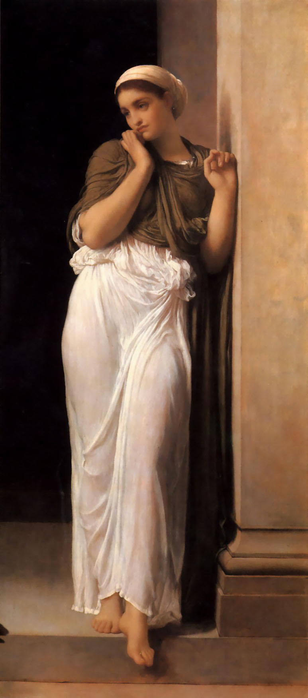
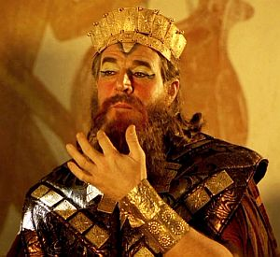
Alcinous=king of phaeacia
Nausicaa=daughter of Alcinous

Slide 5
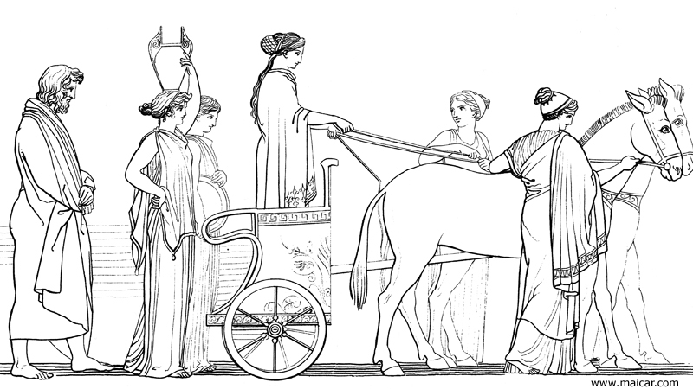
Nausicaa decides to help Ody

Slide 6
Book 7

Slide 7

Ody meets Alcinous and arete

Slide 8

Alcinous likes ody and wants to help him
I like you. Marry my daughter
Thanks but no thanks
Well at least let me help you home
That would be nice
And we’ll have a feast before you go

Slide 9
Book 8

Slide 10
Alcinous has a feast in ody’s honor; pontonous brings ody to tears

Slide 11
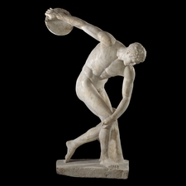
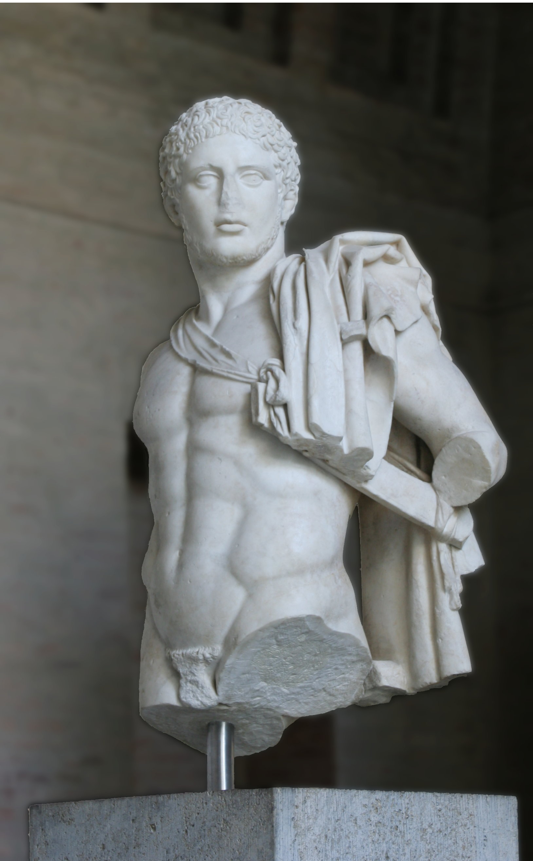
They decide to host some games; Laodamas challenges ody
You’ll regret this
What do you say to some games, old man?

Slide 12

Ody wins and alcinous calls an end to the games
Enough of this you nincompoop

Slide 13
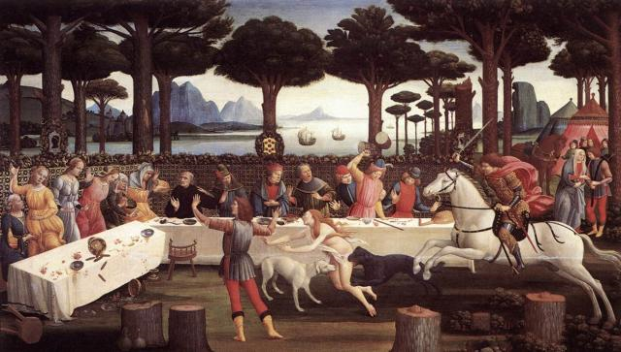
They have another feast and ody tells of his travels

