Slide 1
England in the Dark Ages

Slide 2
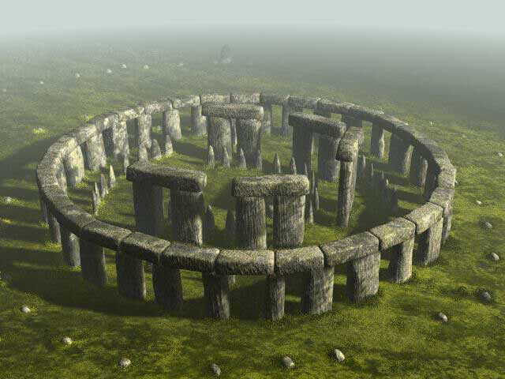
Pre 400
Celts called Brythons inhabit the isle
Julius Caesar (Roman) invades Britain
55 B.C.
Christianity proclaimed official religion of the Roman empire 313 A.D.
Notes:
The stories of the Celts relate to strong individual women, they are full of fantastic animals, passionate love affairs, and adventures.
The Brythons had their own pagan religion. Thus when the Romans invaded in 55 BC, their polytheistic system of religion appealed to the Celts. However, in 313 AD Christianity is proclaimed the official religion of the Roman empire, including in Britain. Romans had to make certain concessions in order to win over the Celts; thus, it is not surprise that the celebration of the Bell Tane Fires, a celebration held during the winter solstice that celebrates the end of darkness and the coming of light, falls around Christmas. It is also no coincidence that the Bell Tane Fires is also referred to as Yule.

Slide 3
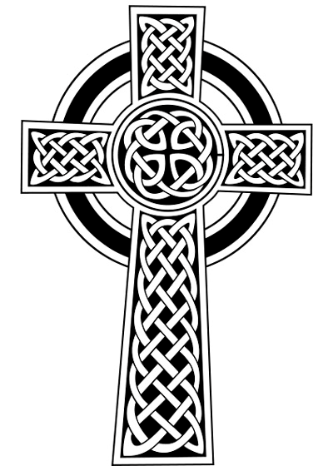
400 A.D.
409 AD, Romans withdraw troops from Briton
They left a legacy of public infrastructure but no political stability
476 AD, Roman empire falls
Fierce Germanic tribes are their downfall
Anglo-Saxons invaded Briton
Notes:
As the Romans made their home in Briton, they established aqueducts, roads, walls, villas, and public baths. What they did not leave was a centralized form of government. Thus, Briton was ruled by several geographic clans. This fractured the nation and left it easy pickings for future invaders.
The Angles and Saxons from Germany and Jutes from Denmark crossed the North Sea to invade Briton. The Celts fought bitterly but were eventually forced to retreat to Whales, a region that to this day sustains the language and echoes of culture of the Celtic people.
With the arrival of the Anglo-Saxons comes a new name for Briton: England

Slide 4
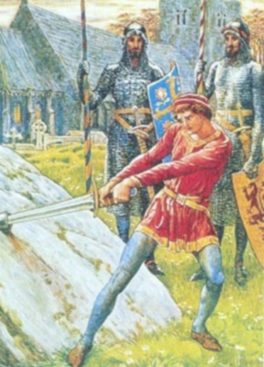
500 A.D.
King Arthur rules the Celtic tribes, circa 516
King Arthur is killed at Battle of Camlann, 537
Saint Augustine converts Anglo-Saxon King Ethelbert, 597
Leads to the creation of a monastery in Canterbury
Notes:
King Arthur was a celebrated Celtic warrior who governed his clan in Whales after the Anglo-Saxons had invaded Briton.

Slide 5
600 A.D
British Christian Church is united with Roman Church, 664
Synod Whitby

Slide 6
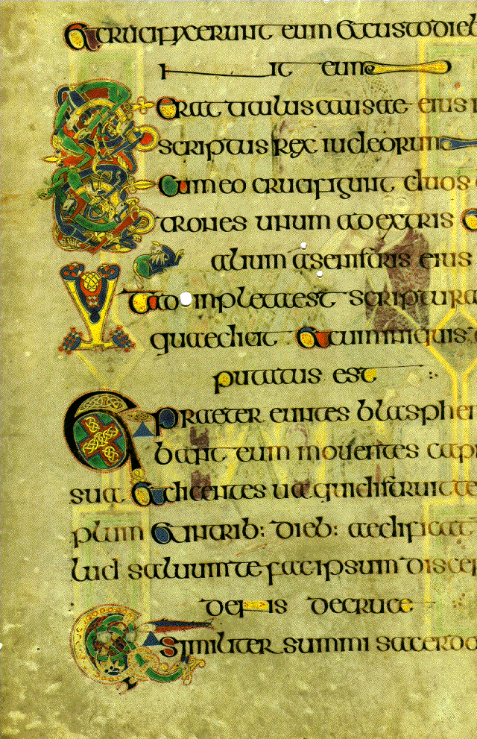
700 A.D.
Beowulf is first recorded, circa 700 A.D.
Monks begin work on Book of Kells illuminated manuscript, 760
Vikings invade Briton, 793
Notes:
Beowulf is to Briton as The Odyssey is to Greece. It is considered the first epic of Briton and is celebrated as the first example of British customs and values. In effect, it helped shape the British psyche of literature for generations to come, including our own.
The work on the manuscript reveals how ingrained Christianity has now become within British society. The books took monks years of painstaking labor to complete.
This Viking invasion sparked a century of invasions. The Vikings were regarded as deadly, vicious warriors.

Slide 7
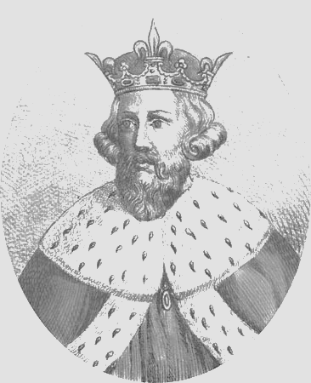
800 A.D.
Alfred the Great is king of England, 849-899
Christianity resurges in popularity
Notes:
King Alfred successfully united England when he led troops against the invading Vikings. While the Vikings eventually took over England, King Alfred’s legacy of a unified nation lived on.
The other unifying agent for England was the resurgence of Christianity. When people had a common faith, they were more willing to work together.

Slide 8
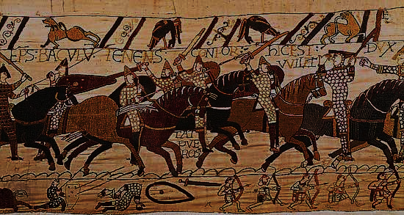
900 A.D-1100 A.D.
The Exeter Book, collection of English poems, first copied, 975
The world’s first novel, Tale of Genji, is written in Japan, Circa 1000
Norman invasion 1066
William the Conqueror King
Notes:
The Normans came from Northwestern France and invaded in 1066. They defeated the Anglo-Saxons and the Vikings thus making England part of the Norman empire.

Slide 9
Anglo Saxon Culture: A look at women
Before the Norman Invasion, women had the following rights:
They could hold property
Even when married they held rights to personal property
Wedding gifts were given by the prospective husband to the bride and she alone controlled this gift
Women became abbesses in churches (high rank)

Slide 10
Anglo Saxon Culture: Barbarians?
Warfare rules the day
Loyalty to the leader brings Fame and Success
Worshipped a series of warrior gods
Similar to Norse mythology
Religion suggests preoccupation with virtues of Bravery, Loyalty, Generosity, and Friendship
Bards provided entertainment (singers/storytellers)

Slide 11
A look at Old English
See if you can identify this familiar work:
Fæder ure þu þe eart on heofonum;
Si þin nama gehalgod
to becume þin rice
gewurþe ðin willa
on eorðan swa swa on heofonum.
urne gedæghwamlican hlaf syle us todæg
and forgyf us ure gyltas
swa swa we forgyfað urum gyltendum
and ne gelæd þu us on costnunge
ac alys us of yfele soþlice
Video Clip

Slide 12
Ever hear of the Lord’s Prayer?
Our Father, which art in heaven, Hallowed be thy Name. Thy Kingdom come. Thy will be done in earth, As it is in heaven. Give us this day our daily bread. And forgive us our trespasses, As we forgive them that trespass against us. And lead us not into temptation, But deliver us from evil. For thine is the kingdom,
The power, and the glory,
For ever and ever.
Amen.
Fæder ure þu þe eart on heofonum;
Si þin nama gehalgod
to becume þin rice
gewurþe ðin willa
on eorðan swa swa on heofonum.
urne gedæghwamlican hlaf syle us todæg
and forgyf us ure gyltas
swa swa we forgyfað urum gyltendum
and ne gelæd þu us on costnunge
ac alys us of yfele soþlice

