Slide 1
Roman history
A Brief background

Slide 2
Key Vocabulary
Patrician—A Wealthy person belonging to the wealthy ruling class
Plebeian—A common person belonging to the common class
Triumvirate—A group of three men ruling together
Consul—An elected leader who ruled the roman republic

Slide 3
500 BCE
Lucius Tarquinius Superbus overthrown 509 BCE
The Last of the Tarquin kings
Two Consuls took their place
Consuls went up for re-election every year
Responsible for making and enforcing laws during peacetime
Responsible for commanding and leading the military during war
In times of great emergency A dictator (supreme commander) would be appointed
This could be in effect for no longer than 6 months
Notes:
The consuls were “democratically” elected, but only by the Patricians in the Senate
Only patricians could elect senators. Senators in turn elected the consuls
To try and prevent corruption of power, consul elections were held annually, but there were not any term limits, so they could run for re-election
They used two consuls to balance power—one could veto the other
The Consuls were expected to lead the military from the front. In times of war, it was not unusual for them to get killed in battle. In the event that that happened, the Senate would appoint another consul to finish out the term and then elections would follow as usual the next year
Great Emergency was for things like war wherein the battles had gotten out of hand and the consuls were in over their head. This appointment was generally given to someone with considerable military experience—in modern times, think of the president handing over control to a 5-star general.
The 6 month limit was to ensure that power was not abused. If wartime was still going on, the Consuls would be reappointed to see if they could work things out. If they couldn’t a new Supreme Commander would take their place.

Slide 4
300 BCE
First Plebian consul elected in 367 BCE
Once consul was supposed to be plebian in birth after that
This did not actually happen until 63 BCE
Elections were supposed to be based on military accomplishment and leadership abilities
More often consuls were elected for political reasons
Notes:
Lex Licinia Sextia recommended that the plebeians have greater representation in government. It was he who recommended the laws be changed to have one consul come from the Plebeian class and the other come from the Patricians. While this was technically a law, in 304 years between when the law was put in place and when Cicero came along, only 15 Plebeians ruled as Consuls
Money was definitely a motivator for elections. Oftentimes incompetent consuls were thrust into power merely because they promised favors. Even the plebeian consuls were not immune to this
Even with a Plebeian consul, the Patricians still had control over the senate, so they ruled overwhelmingly

Slide 5
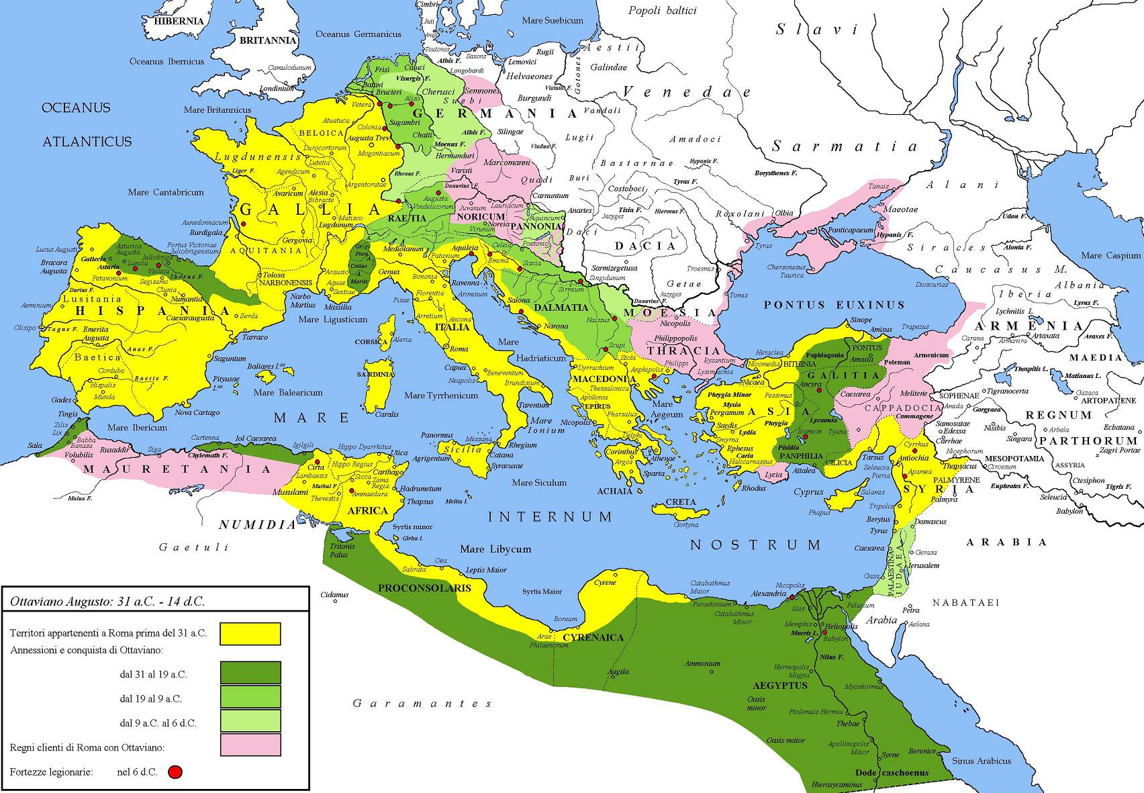
Roman Empire Expands
Conquered the rest of Italy, Greece, Spain, and north Africa
Increased overall wealth of empire
Those in power cared less about the people and more about themselves
Power shifted into the hands of the few
Notes:
Money and power definitely went to the heads of the Patricians who were senators and consuls. They concerned themselves more with buying items of luxury and living lavish lifestyles than they did with taking care of the plebeians
The people who came out on top were those who could afford to hold their own private armies and use their military might to control the senate and who could eliminate their political enemies by either influencing elections or murder

Slide 6
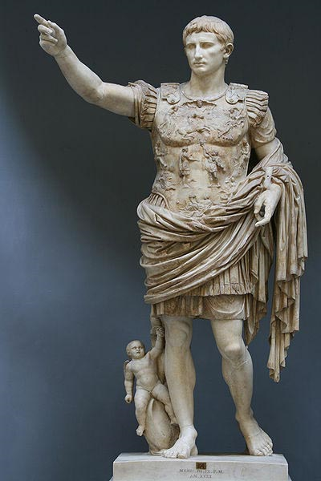
A leader emerges: Julius Caesar
Born July 13, 100 BCE to a patrician family that wasn’t very influential
Father died when he was 16
Elected military tribune age 22
Elected Quaestor Age 31
Elected Praetor Age 38
Elected Consul Age 41
Notes:
Caesar had to become the head of his household after his father died. This began in effect his military career because he needed to maintain his family and settle his father’s debts
He was extremely accomplished in the Gallic Wars. Military Tribune was the first step in his political career. It essentially gave him political power and the rank of a modern day colonel.
Quaestors supervised the state treasury and performed audits. This was seen as a beginning step for one interested in politics
Praetors were commanders of the army and small-time judges
Caesar was not above using bribes and other means to attain his political power, including that of consul

Slide 7
The First Triumvirate
59 BCE—Caesar, Pompey, and Crassus all elected consuls
Caesar makes an alliance so all three of them can rule
This alliance is shaky at best
Crassus supports Caesar financially under the table
Civil war between the three breaks out
Crassus dies in 53 BCE
Pompey flees to Egypt and gets murdered 48 BCE
Caesar wins the title of Dictator Perpetuus 48 BCE
Notes:
This was a contentious election that was too close to call among the three men
Caesar saw the continued controversy over the election as politically ruinous for himself, so he convinced the other two men to share the power equally
Caesar and Pompey were bitter enemies
Crassus and Pompey were bitter enemies
Caesar and Crassus were kinda friends
Crassus never got over his disdain for Pompey. Caesar just saw Pompey as another roadblock in his way of achieving his goal, total control of Rome
Crassus dies in a battle in Syria. He had to walk a political tightrope because he had to look like he was fighting for himself when really he was backing Caesar.
Dictator Perpetuus meant he was the permanent head of government. Only by dying would his reign end.

Slide 8
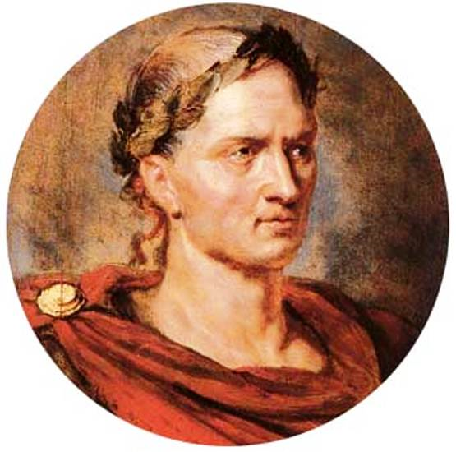
Caesar’s Rule
Merciful towards Pompey’s supporters
Brutus and Cassius
Relieved the debt of the Roman Empire
Reformed the senate
Reformed the calendar
Reorganized local governments
Resurrected 2 city states (Carthage and Corinth)
Gave citizenship to several foreigners
Notes:
Brutus and Cassius were Patrician senators who backed Pompey. Caesar had every right to kill them for treason. Instead, he kept them around and promoted them politically. He mistakenly believes that by giving them power, he is making them his friends. Cassius especially however will not forget the injuries inflicted upon him by Caesar
His senate reform involved increasing its size and opening it up to more plebeians so that it better represented all the people of Rome. The citizens saw this as great. The patricians saw this as a threat to their power.
The calendar that Caesar standardized is the one we use today. Previously, it was based off of the lunar calendar of 355 days and rulers were supposed to add days at their discretion to make sure the days matched up with the seasons. This didn’t always happen, with the result that it was confusing and days didn’t match up with the seasons. Caesar standardized a 365 day calendar with a leap year every 4 years.
Previous rulers let Carthage and Corinth wither and die by themselves. He saw them as Roman citizens, so he wanted to bring them back into the fold.

Slide 9
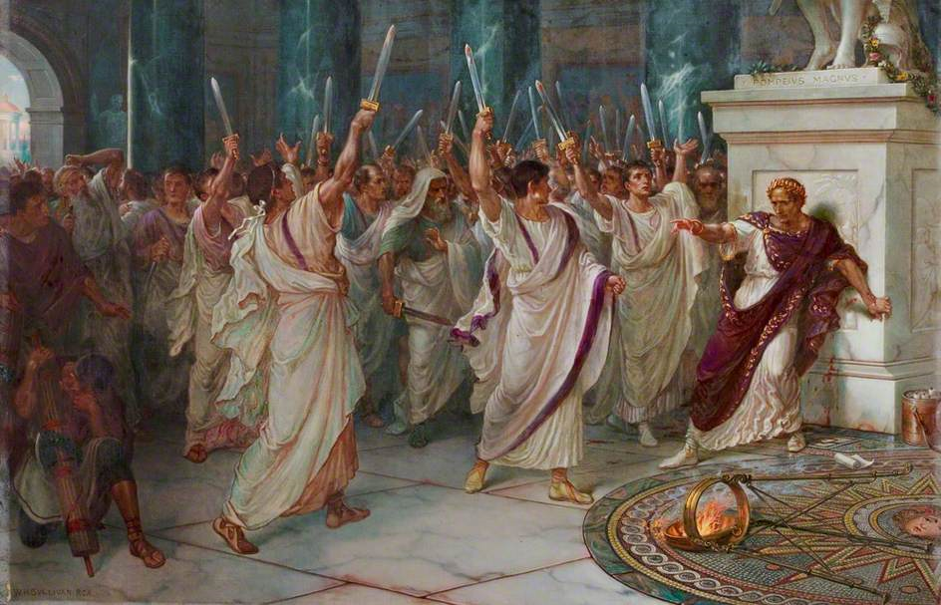
Caesar’s End
Only ruled for 4 years
March 15, 44 BCE—Caesar is assassinated
60 men conspired against him
Stabbed 23 times
Only one was life threatening (senators don’t make very good assassins)
Became a martyr for the people
Marc Antony helps avenge Caesar with the people
Notes:
Men like Cassius and Brutus were worried that Caesar planned on declaring himself king and get rid of the republican system entirely by disbanding the senate.
44 BCE Cassius recruited men like Brutus for an assassination attempt on Caesar before he could declare himself king
His death was probably pretty slow and painful
The people loved him for the reforms that he did and his accomplishments on the battlefield. They saw him as a man for the common people. They saw his assassination as an attempt by patricians to keep the power centralized in the hands of the few.
Marc Antony was a military buddy of Caesar’s

Slide 10
Fun Facts
Caesar had epilepsy
His last name (Caesar) comes from an ancestor who was born by Caesarian section
Caesar had several mistresses
One was Cleopatra VII, Queen of Egypt
They had a son together, Caesarion
Marc Antony shacked up with her too once Caesar was killed
Married 3 times
Was captured by pirates
Father of the leap year

Slide 11
Shakespeare’s Version
Written in 1599
Has several parallels to Queen Elizabeth:
Both are childless
Both have nephews who ascend the throne
Both were accomplished warriors
Both are merciful to their enemies
Both were beloved by the people
Both changed the way their countries were governed
Less than 50 years after Shakespeare wrote his play on Caesar, English people executed their king and set up a republic
Notes:
This is the first history play of Shakespeare’s that doesn’t deal with English history. Why now? Queen Elizabeth was nearing the end of her reign (died in 1603), so this could be Shakespeare’s premonition of what was to come after she died
Shakespeare never wrote a play about Queen Elizabeth, though he wrote ones about her father, grandfather, etc. It’s possible that he just ran out of time (the Globe burned down when one of the cannons used for sound effects during a production of Henry VIII misfired
It’s also possible he didn’t bother because she was after all a woman
Or maybe JC is in fact her play under a different name
Elizabeth didn’t sit idly by during battle. Through her leadership, the British defeated the Spanish armada, the most imposing and powerful navy of her time. It ushered in an uninterrupted period of peace and prosperity in England longer than any other before or since
40 years in fact
Caesar pardoned Cassius and Brutus after Pompey’s death. In fact, he didn’t even want Pompey dead and allowed him to flee into Egypt. It was one of Caesar’s followers who thought he was doing the right thing by killing Pompey
While both definitely made moves to retain their power, they also thought of the common man. Elizabeth ended the practice of persecuting Catholics, choosing instead to just charge them a reasonable tax for their faith. Caesar gave them greater representation in government.
As Liz reached the end of her life, there was concern about a political revolt. Elizabethans would be worried when JC was killed in act 3, but they could also breathe a sigh of relief when the rightful inheritor of the crown took over. It was Shakespeare’s way of saying, hey there might be a political vacuum after she dies, but the right ruler will come out in the end
Queen Elizabeth was a great queen. Her nephew James was largely disliked, but decent. His son Charles was terrible, wasteful, indecisive, insecure, and arrogant. The people revolted against him, killed him, sent his son (also called Charles) into exile, and appointed Oliver Cromwell as Parliamentary and Puritan Dictator of England. He started out really great and then the power went to his head and civil wars began to break out. When he died, his son was not up to filling the task, so they got Charles II back and reinstated the monarchy.

